Slide 1
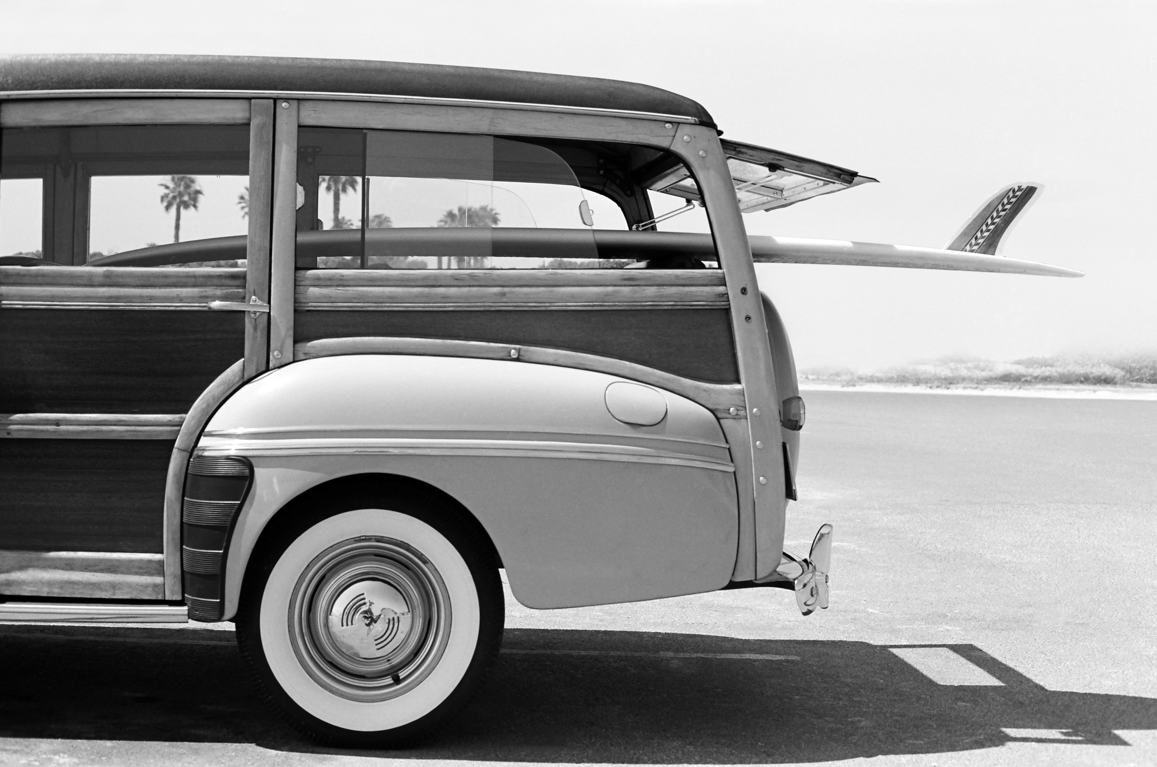
Vehicle Motion detection
Jaycel Estrellado
Michael Chung

Slide 2


Agenda
- Introduction
- Demo Project Results
- Code and Progress overview
- Key differences of frame difference and background subtraction
- Questions
Vehicle Motion Detection
2023

Slide 3
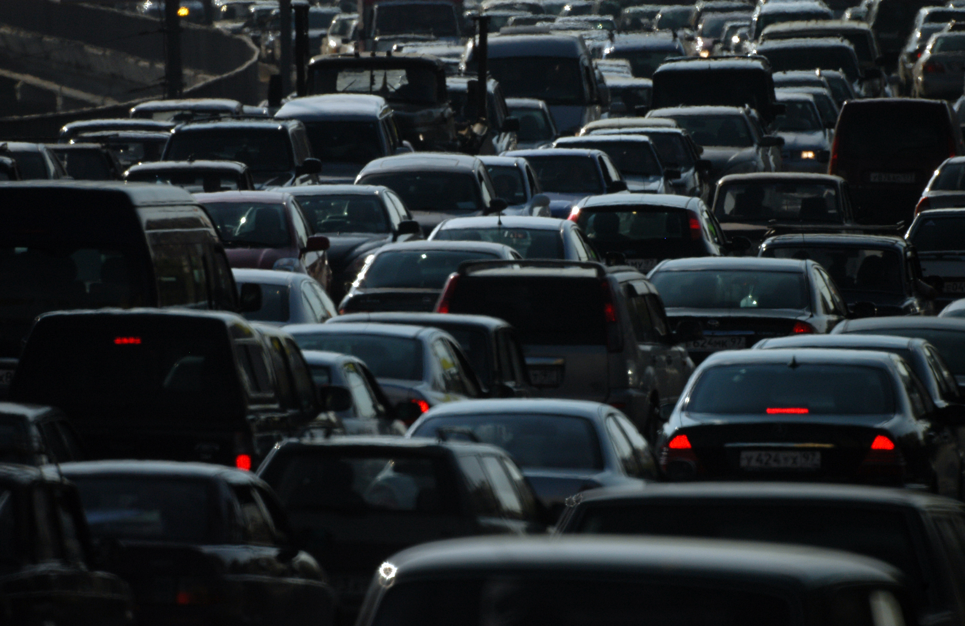
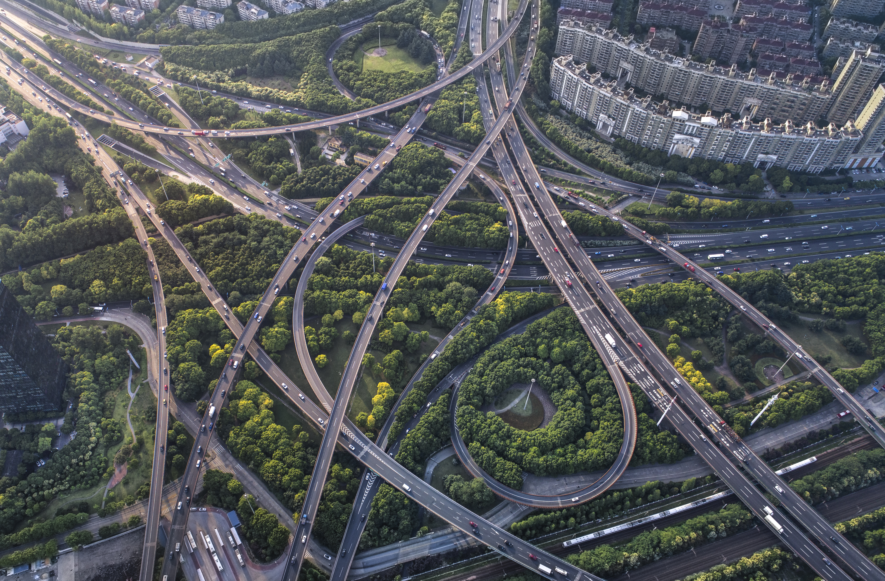
Introduction
- Real-time capture of Vehicle Motion.
- Our goal is to collect different camera angles, exploring motion detection in different environments and lightings.
- E.g Snowy Terrains, Dark lightings etc.
Vehicle Motion detection
2023

Slide 4

- Track moving objects to monitor surveillance videos and capturing vehicle motion.
- plays a major part for controlling and managing traffic.
What is Vehicle Motion Detection?

Slide 5
Project TIMELINE
Week 3-4
Week 7
Choose videos with different camera angles, environment and lightings.
Test on the different challenge if it works and improve the code.
Research on what algorithms can be used. Chose the method Background Subtraction.
Worked on the improved approach and code.
Week 5-6
Week 8-9
Vehicle Motion Detection
2023

Slide 6
- Applied contouring techniques
- Employed background subtraction and frame difference
Techniques Implemented:

Slide 7

Background subtraction
Sample Footer Text
2023

Slide 8
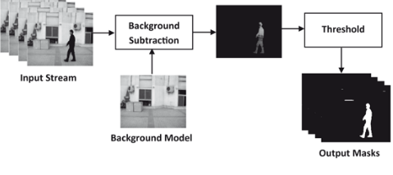
Background subtraction
- First few weeks, we implemented our project using Background Subtraction.
- Most effective method to detect and extract objects from images or videos.
- It’s a technique to separate the foreground elements from the background model.
- Videos are divided into separate frames. Each frame is read and enclosed within bounding boxes.
Vehicle Motion detection
2023
Notes:
05/12/2023

Slide 9
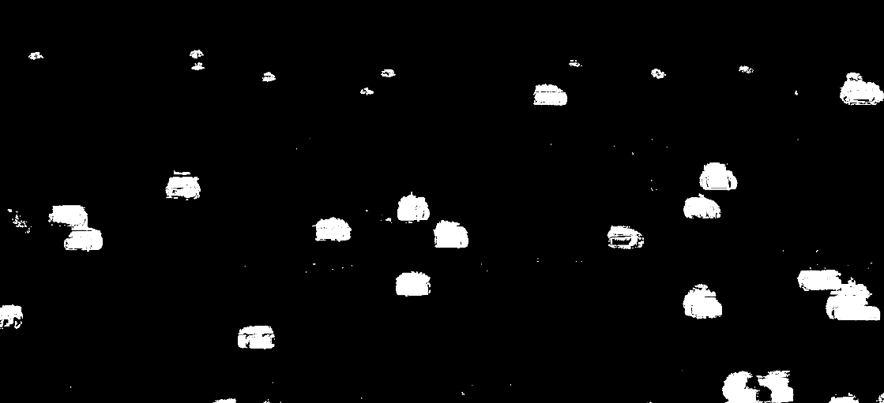
How is this done?
- Initialize the background model (no cars present).
- Update the background model with the new frame.
- Get the foreground mask (as seen below).
- Get initial motion detection from the mask.
- Repeat.
Vehicle Motion detection
2023
Notes:
05/12/2023

Slide 10
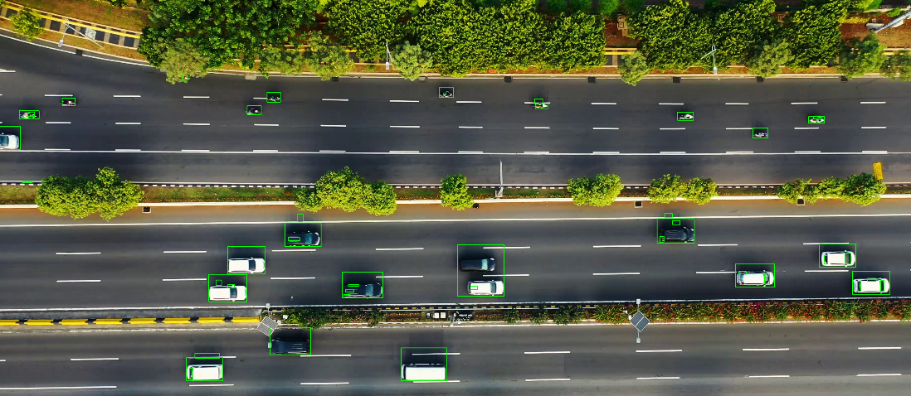
results
Vehicle Motion detection
2023
Notes:
05/12/2023

Slide 11
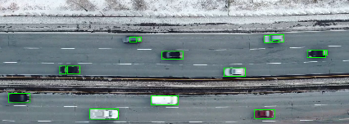
results
Vehicle Motion detection
2023
Notes:
05/12/2023

Slide 12
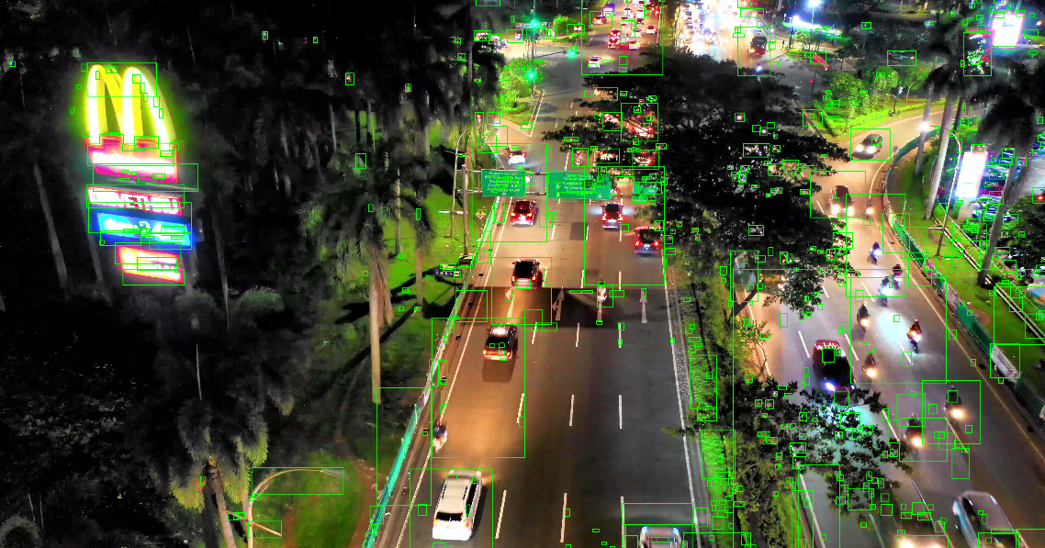
results
Vehicle Motion detection
2023
Notes:
05/12/2023

Slide 13
Frame difference
Sample Footer Text
2023

Slide 14
Frame difference
- To solve our problem, we implemented another algorithm called Frame Difference.
- It identifies an object’s motion and differentiate an object (vehicles in this case) moving around the environment.
- The main idea is to perform thresholding on each frame to get a motion mask about the objects moving in the video.
Vehicle Motion detection
2023
Notes:
05/12/2023

Slide 15
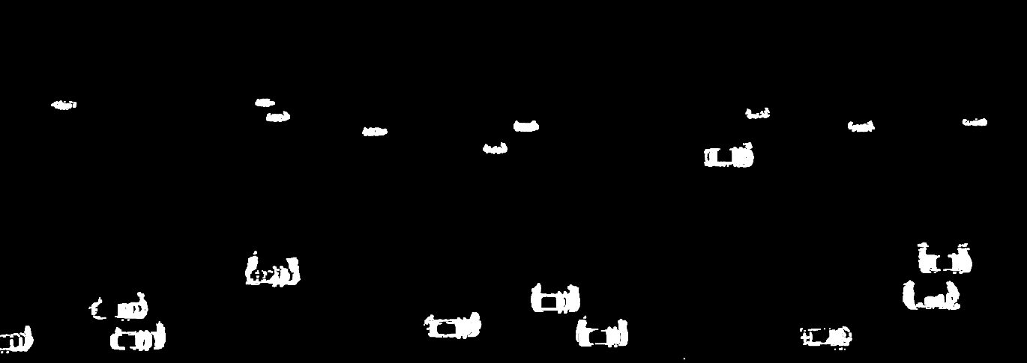
How is this done?
- Applied Gaussian blur to remove random noise from frames.
- Thresholding
- Reading two frames and looping over each contour found in the frame.
- We noticed that this implementation gave a more seamless result compared to Background Subtraction.
Vehicle Motion detection
2023
Notes:
05/12/2023

Slide 16




Summary
- Vehicle Object Detection uses various sensors and algorithms to identify and locate vehicles in video streams.
- It recognizes and tracks vehicles in real-time to support surveillance videos and monitoring traffic.
- By employing techniques like bounding boxes, vehicle object detection enhances safety, efficiency and overall traffic management.
Vehicle Motion Detection
2023

Slide 17

Questions?
Vehicle Motion Detection
2023

Slide 18

References
Springernature.com. 2023. Available from: https://media.springernature.com/original/springer-static/image/chp%3A10.1007%2F978-3-319-07386-6_3/MediaObjects/321700_1_En_3_Fig1_HTML.gif
Berrios I. Introduction to Motion Detection: Part 1 [Internet]. Medium. 2023 [cited 2023 Dec 5]. Available from: https://medium.com/@itberrios6/introduction-to-motion-detection-part-1-e031b0bb9bb2
Huls M. Detecting Motion with OpenCV — Image Analysis for Beginners [Internet]. Medium. Towards Data Science; 2022. Available from: https://towardsdatascience.com/image-analysis-for-beginners-creating-a-motion-detector-with-opencv-4ca6faba4b42
Vehicle Motion Detection
2023

Slide 19
Thank you
Vehicle Motion Detection
2023

